Slide 1
Cass Freight Index Shipment

Slide 2
Cass Freight Index: Shipments
What It Measures
Monthly freight expenditures and shipment volumes from Cass Information Systems' client base
Covers tens of millions of invoices and billions in freight spend annually across diversified industries
Data Scope & Limitations
Client-based only: Non-Cass clients are not covered
Timing lag: Data reflect the month invoices are processed, which may differ from actual shipment month
Adjustments applied:
  Normalized to 21-day work months for consistency
  Adjusted for client additions/deletions to enable fair month-to-month comparison

Slide 3
Cass Freight Index: Shipments
How to Interpret
Rising Readings | Falling Readings
More shipping activity | Weakening shipment volumes
Stronger goods demand | Softening demand or inventory adjustments
Healthier freight/logistics environment | Supply chain pressures or contraction

Slide 4
Observation/ Findings
The index is periodic, drops from mid Q3 until early Q1 next year
1990 - 2024
--- Peak around Sep (Aug–Oct window) ---
Years evaluated (have Aug–Oct): 36
Drop from peak(Aug–Oct) to Dec: 34
No drop from peak(Aug–Oct) to Dec: 2
--- SPY behavior when Cass drops (peak->Dec) ---
Years with SPY available: 32
Cass drop years: 31
SPY down given Cass drop: 7
SPY up given Cass drop: 24

Slide 5
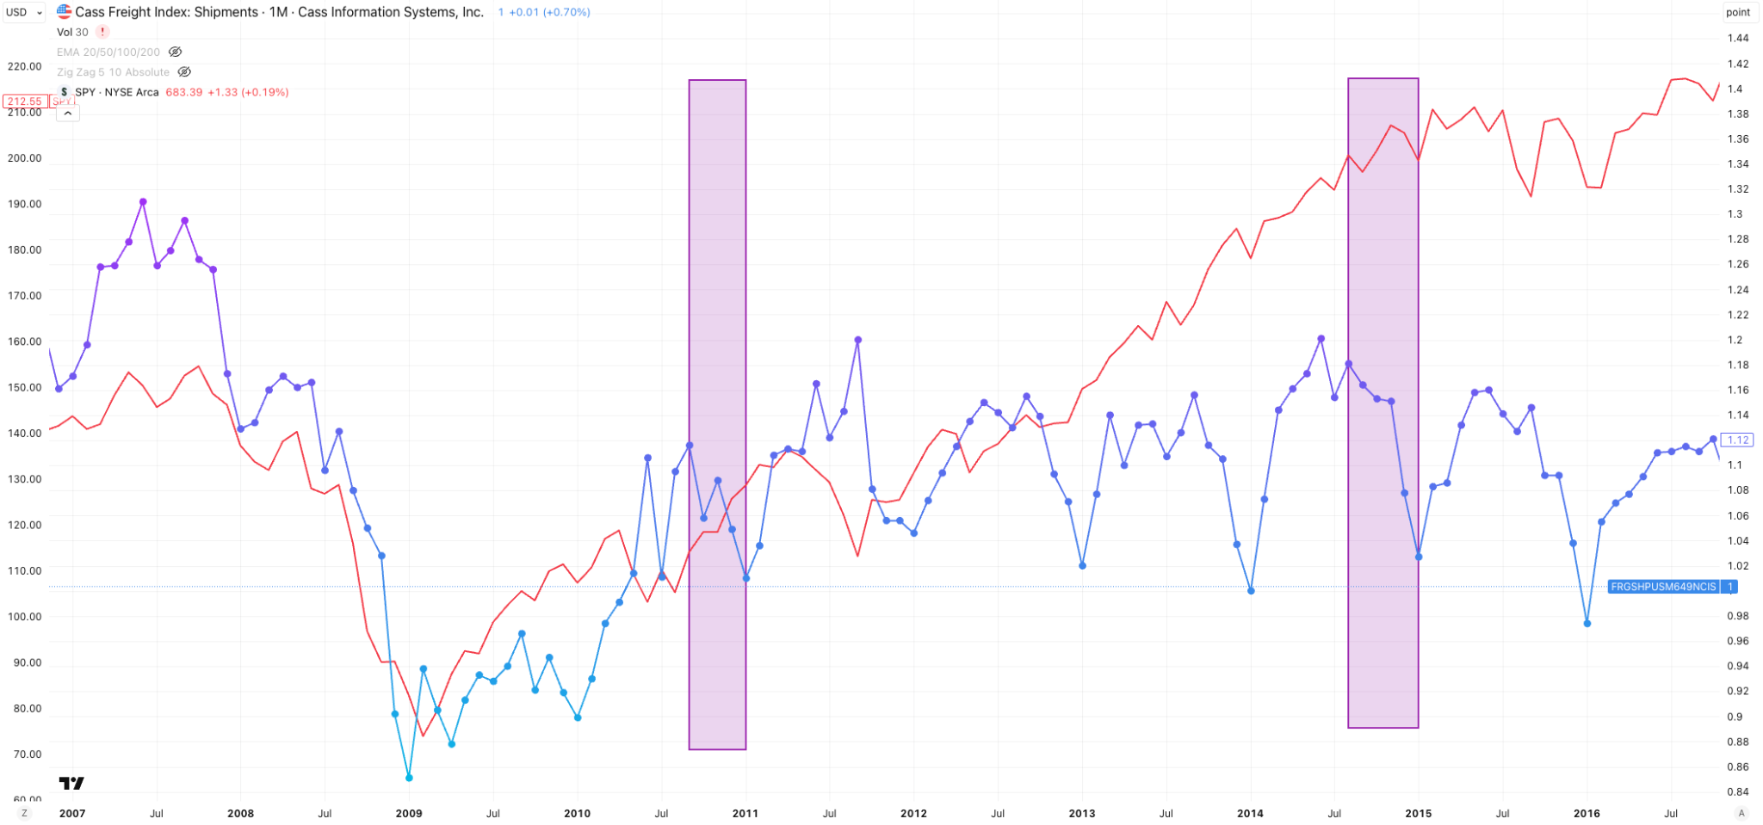

Slide 6
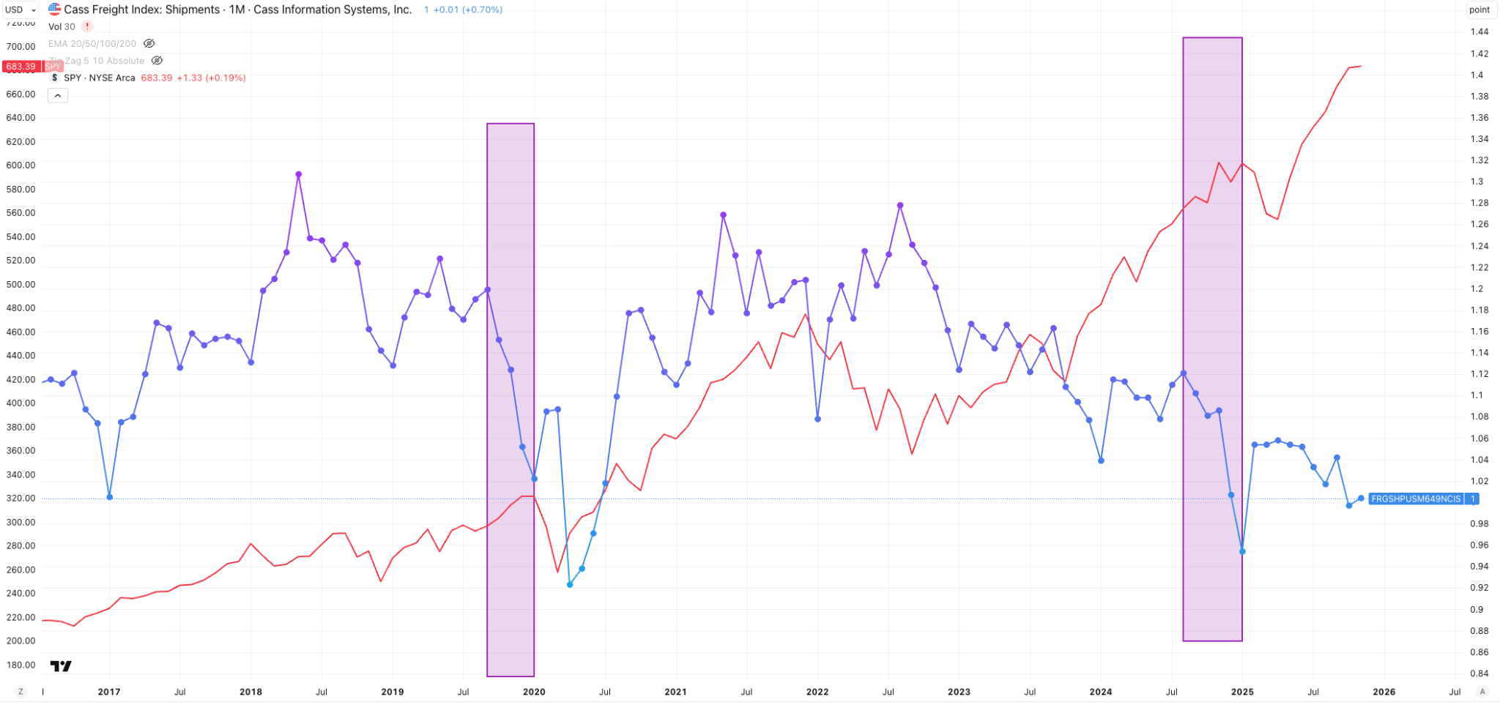

Slide 7
Seasonality
The analysis indicates seasonality in your data:
Seasonal Decomposition: The additive model shows a seasonal component with significant variation (standard deviation: 0.023).
Autocorrelation: Strong autocorrelation at lag 12 months (0.6177), well above the 95% confidence interval, indicating a yearly seasonal pattern.
Monthly Means: ANOVA test (p-value: 0.0386) shows monthly means are significantly different, confirming seasonality.
Monthly Pattern: September has the highest average (1.1218), while January has the lowest (1.0323).

Slide 8
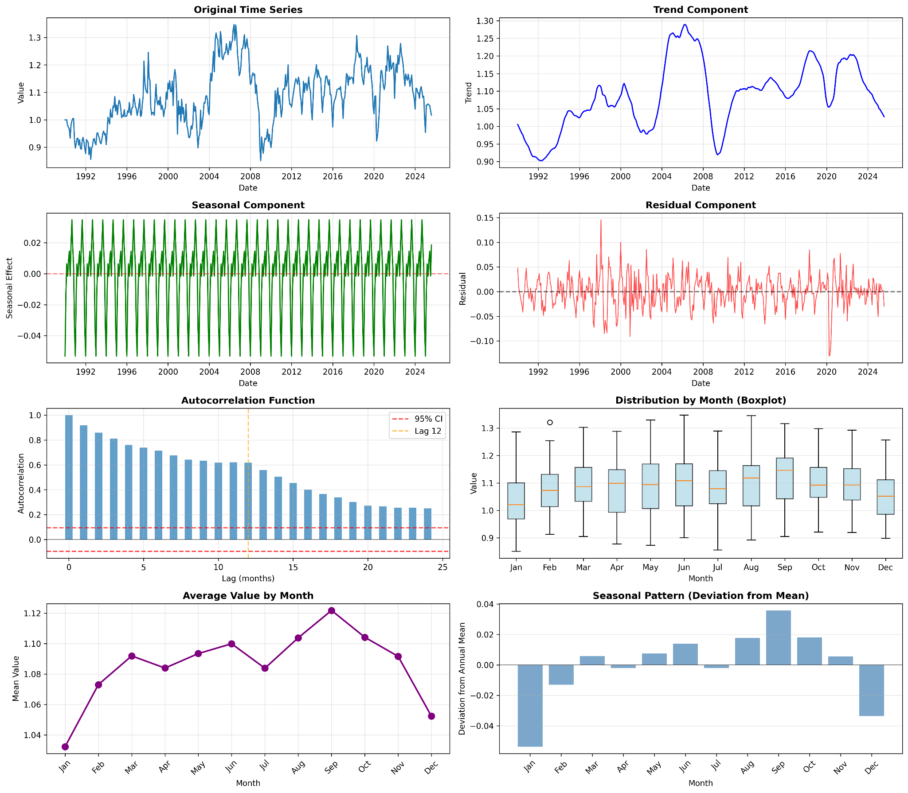

Slide 9
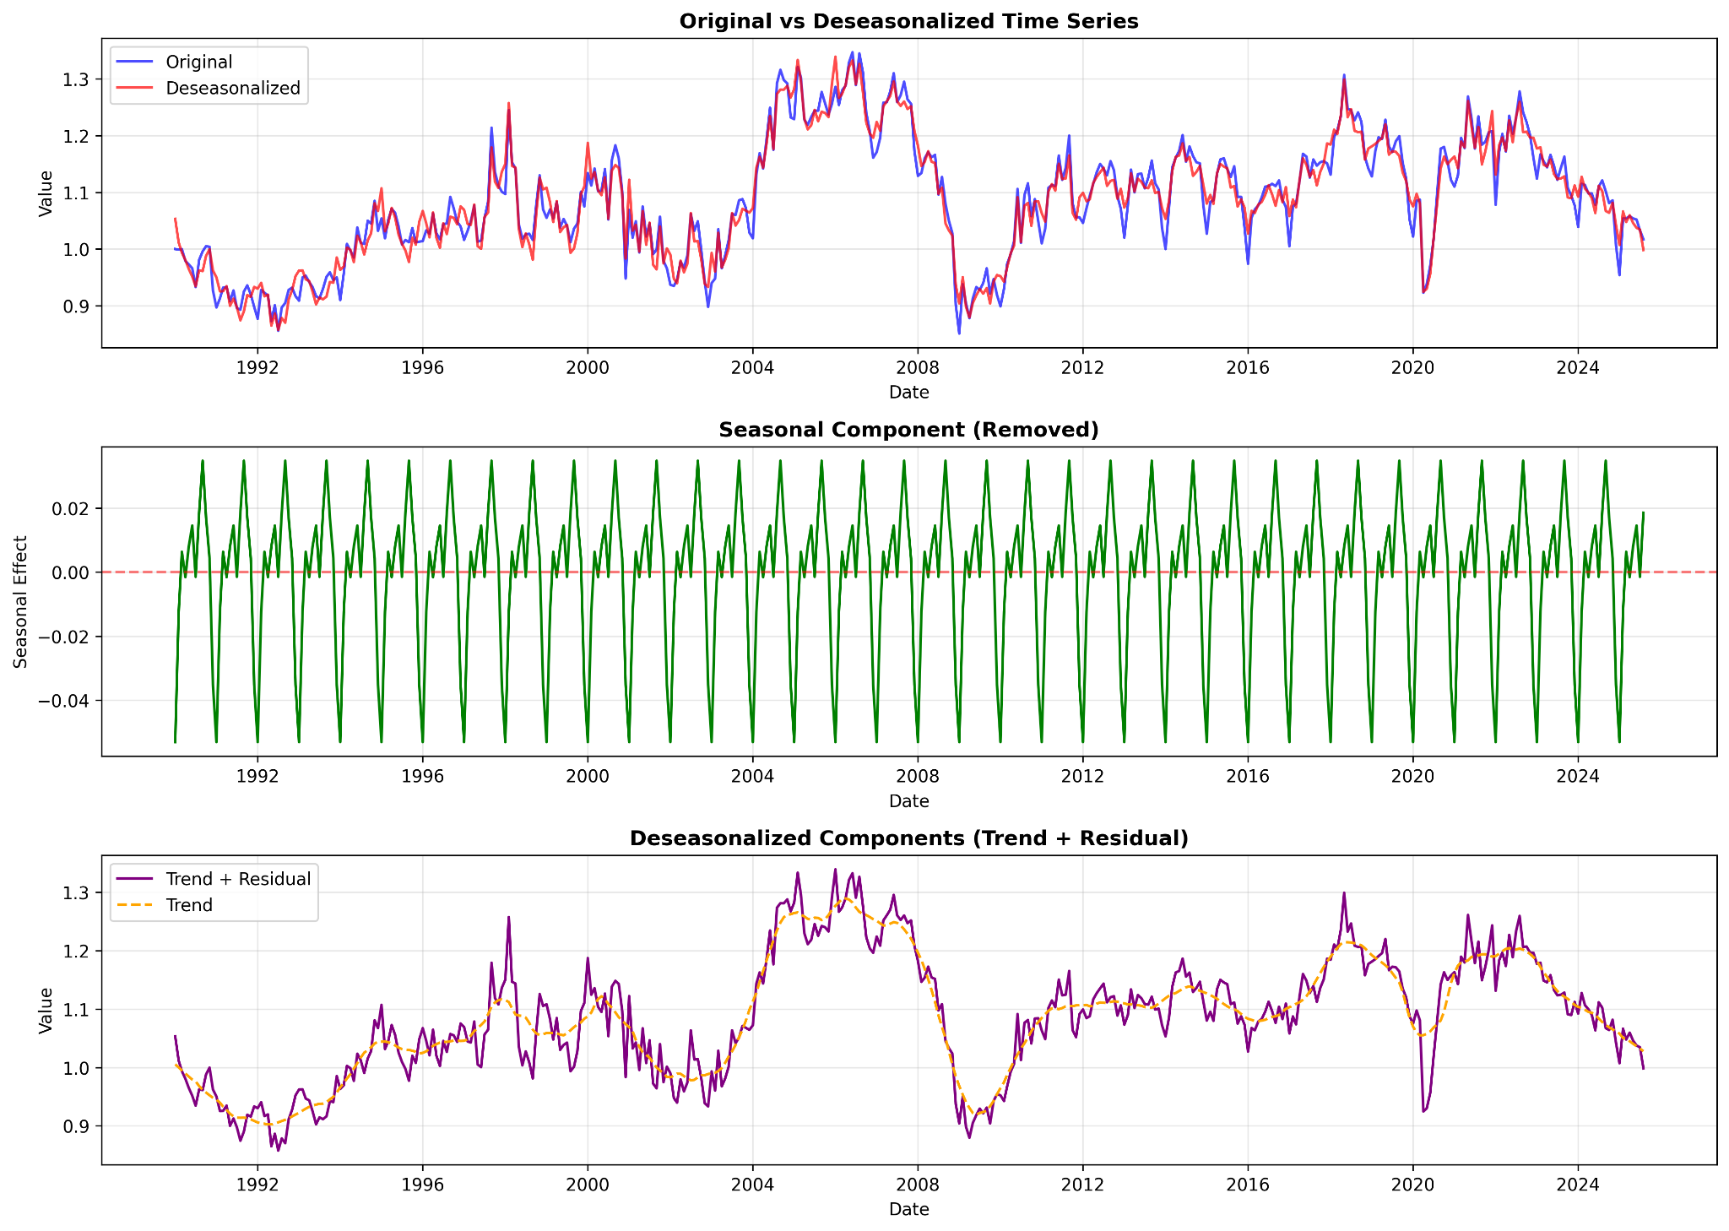
Model used: Additive (automatically selected)
Variability reduction: 2.41% (standard deviation reduced from 0.106 to 0.104)

Slide 10
Freight Peak-Drop Analysis
SPY Reaction
Mostly Positive. SPY typically rises (avg +4.51%) during these freight drops.
Correlation (All Years): 0.4164
Correlation (Drop Years Only): 0.6286
3. Understanding the "Positive Correlation"
You asked: "Why the correlation is positive? The Freight Index drops and SPY goes up."
This is because "Correlation" measures how two variables move relative to their means, not just whether they have the same sign.
Scenario A (Good): Freight drops mildly (-2%). SPY rises strongly (+10%).
Scenario B (Bad): Freight drops severely (-24%, e.g., 2008). SPY crashes (-35%).
In both cases, a "Lower Freight" (more negative) corresponds to a "Lower SPY" (less positive or negative). Thus, the relationship is positive.

Slide 11
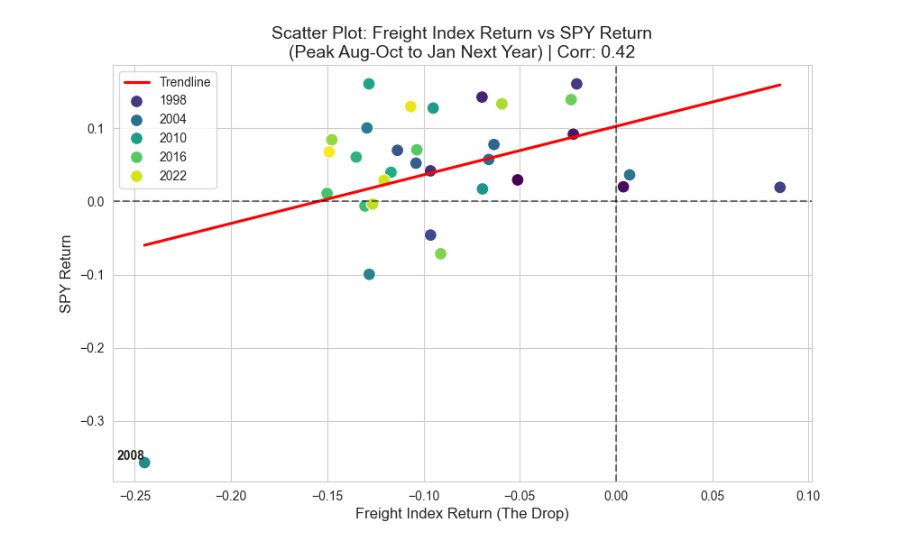
Top-Left Quadrant: Most points are here. Freight Drops (negative X), SPY Rises (positive Y).
Bottom-Left Quadrant: The "Crisis" zone (e.g. 2008). Freight Drops massively, and SPY Drops massively. Use this as a risk signal: if Freight is dropping fast, watch out.

Slide 12
Limitation
Can’t predict when the Index peaks
Need to wait 2 months to calculate % change to determine if it is a mild change

Slide 13
Signal Impact Analysis (Trading the Drop)
I tested a strategy: "When the Freight Index Drop is CONFIRMED (data release), Buy SPY for 3 Months."
Trigger: Peak in Aug-Oct. Drop confirmed in official data release (approx. 1 month lag).
Action: Buy SPY. Hold 3 months (typically Q4: Oct-Dec).
Results (1993-2024):
  Strategy Return: +2.86% (Average per 3-month trade)
  Benchmarks Return: +2.36% (Average 3-month SPY return in general)
  Alpha: +0.50%
  Win Rate: 73.3% (vs 69.3% benchmark)
Conclusion: Buying the pattern works. The "Freight Drop" coincides with the strong seasonality of the stock market (Q4 Rally). It is not a bearish signal; it is a bullish seasonal confirmation.

Slide 14
Cass Freight Index VS SPY (1990 - 2025)
Lag (Months) | Correlation
-----------------------------------
0 | -0.0446
1 | 0.0114
3 | 0.0507
6 | -0.0807
9 | 0.0898
12 | -0.0729

Slide 15
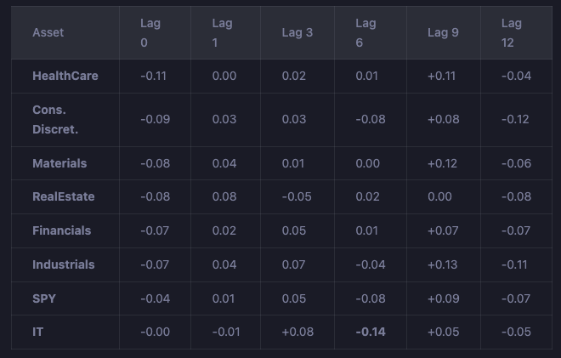
Sector Lag Analysis

Slide 16
Methods to forecast the Index
Method 1: Historical Peak Analysis
Analyzes historical patterns from 1990–2025
Finds that September is the most common peak month (47.2% of years)
Method 2: Seasonal Decomposition-Based Prediction
Uses seasonal decomposition (trend + seasonal + residual)
Extrapolates the trend forward and adds the seasonal component
Method 3: SARIMA (Seasonal ARIMA)
Time series forecasting model that captures seasonality and autocorrelation
Automatically selects best parameters (SARIMA(1,1,1)(0,1,1,12))
Method 4: Historical Average with Trend Adjustment
Uses average historical peak value (1.1309)
Adjusts for recent trend (-0.0730 per year, indicating declining peaks)

Slide 17
Month | Method 1: Historical Aver | Method 2: Seasonal Decomp | Method 3: SARIMA | Method 4: Historical + Tr | Actual Value
Sep-25 | 1.1218 | 1.0853 | 1.0266 | 1.1176 | 1.042
Oct-25 | 1.1041 | 1.0677 | 1.0044 | 1.0958 | 0.997
Nov-25 | 1.0916 | 1.0552 | 0.9944 | 1.0791 | 1.004
Dec-25 | 1.0523 | 1.0158 | 0.9611 | 1.0357 | 0.93191
Jan-26 | 1.0323 | 0.9967 | 0.9223 | 1.0115
Feb-26 | 1.073 | 1.0387 | 0.9787 | 1.0481
Mar-26 | 1.0919 | 1.058 | 0.9907 | 1.0628
Apr-26 | 1.0839 | 1.05 | 0.9779 | 1.0507
May-26 | 1.0934 | 1.0604 | 1.0004 | 1.056
Jun-26 | 1.0999 | 1.0675 | 0.9905 | 1.0584
Jul-26 | 1.0838 | 1.0508 | 0.9851 | 1.0381
Aug-26 | 1.1038 | 1.0719 | 1.0019 | 1.0539

Slide 18
